Slide 1
COMP-4150 ADVANCED AND PRACTICAL DB SYSTEMS
PART-B- PL/SQL
Fall-2019

Slide 2
OUTLINE
SECTION-I - Introduction
PL/SQL Overview
Anonymus Blocks
Data Types
Variables
Comments & Constants
SECTION-II- Condition Control & LOOPS
IF statements
Case Statements
GO TO & NULL Statements
LOOPS (FOR, WHILE)
SECTION-III- Stored PROCEDURES and FUNCTIONS
Procedures
Functions
Cursor Variables
SECTION-III- CURSORS
Cursor FOR LOOP
Cursor With Parameters

Slide 3
OUTLINE
SECTION-V-Packages
PL/SQL Packages
File Structure
SECTION-VI-Triggers
Statement Level
Row Level

Slide 4
SECTION-I - Introduction
PL/SQL Overview
Anonymus Blocks
Data Types
Variables
Comments & Constants

Slide 5
PL/SQL
Procedural Language extensions to the “Structured Query Language”
SQL is a popular language for both querying and updating data in the relational database management systems (RDBMS).
PL/SQL adds many procedural constructs to SQL language
PL/SQL provides a more comprehensive programming language solution for building mission-critical applications on Oracle Databases.
PL/SQL is a standard and portable language for Oracle Database development.
PL/SQL is an embedded language. PL/SQL only can execute in an Oracle Database

Slide 6
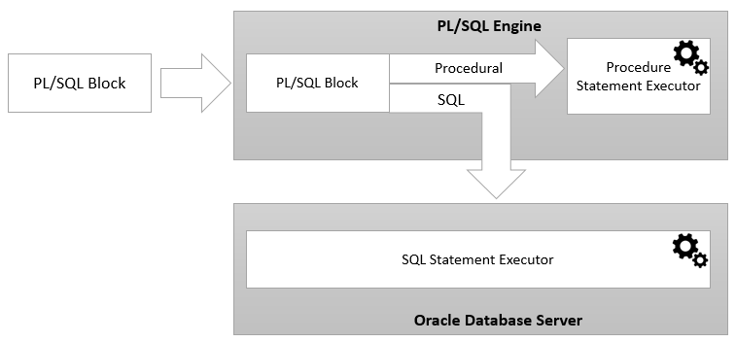
PL/SQL Architecture
PL/SQL engine
Compile PL/SQL code into byte-code and executes the executable code.
Can only be installed in an Oracle Database server or an application development tool such as Oracle Forms.
Once you submit a PL/SQL block to the Oracle Database server, the PL/SQL engine collaborates with the SQL engine to compile and execute the code.
PL/SQL engine runs the procedural elements while the SQL engine processes the SQL statements.

Slide 7
PL/SQL Anonymous Block
PL/SQL is a block-structured language whose code is organized into blocks.
A PL/SQL block consists of three sections:
Declaration [optional]
Executable [mandatory]
Exception-handling [optional]
Named Block
A PL/SQL block has a name. Example: Functions or Procedures
A named block is stored into the Oracle Database server and can be reused later.
Anonymous Block
A block without a name is an anonymous block.
Not saved in the Oracle Database server, so it is just for one-time use.
Useful for testing purposes.

Slide 8
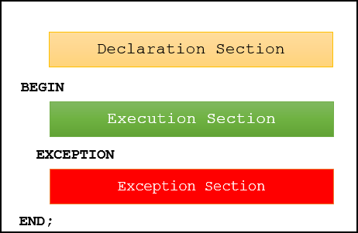
PL/SQL Block Structure
Declaration Section
Declare variables, allocate memory for cursors, and define data types.
2) Executable Section
Starts with the keyword BEGIN
Ends with the keyword END
Must have a least one executable statement, even if it is the NULL statement which does nothing
3) Exception-handling Section
Starts with the keyword EXCEPTION.
Catch and handle exceptions raised by the code in the execution section
Note a block itself is an executable statement, therefore you can nest a block within other blocks.
1 2 3 | BEGIN DBMS_OUTPUT.put_line ('Hello World!'); END;

Slide 9
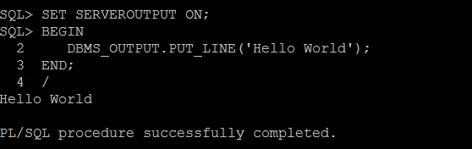
Execute a PL/SQL anonymous block using SQL*Plus

Slide 10
Steps to Execute PL/SQL Block
First, connect to the Oracle Database server using a username and password.
Second, turn on the server output using the SET SERVEROUTPUT ON command so that the DBMS_OUTPUT.PUT_LINE procedure will display text on the screen.
Third, type the code of the block and enter a forward slash ( /) to instruct SQL*Plus to execute the block.
Once you type the forward-slash (/), SQL*Plus will execute the block and display the Hello World message on the screen as shown in the illustrations.
Note that you must execute SET SERVEROUTPUT ON command in every session that you connect to the Oracle Database in order to show the message using the DBMS_OUTPUT.PUT_LINE procedure.
To execute the block that you have entered again, you use / command instead of typing everything from the scratch:

Slide 11
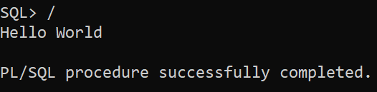
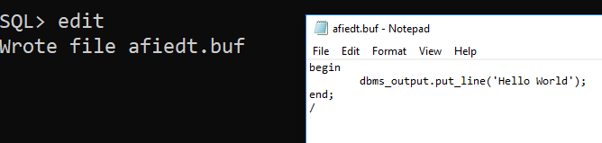
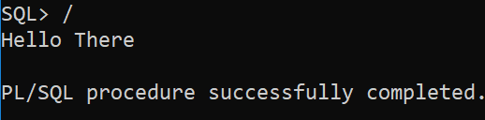
Executing & Editing a block

Slide 12
PL/SQL Data Types
PL/SQL has two kinds of data types:
Scalar
Store single values such as number, Boolean, character, and datetime
Composite
Store multiple values, for example, record and collection.
PL/SQL divides the scalar data types into four families:
Number (real numbers, integers and float),
Boolean (TRUE, FALSE, NULL)
Character (CHAR(n), VARCHAR2(n)
Datetime

Slide 13
PL/SQL Variables
Named storage location that stores a value of a particular data type.
Before using a variable, you must declare it in the declaration section of a block.
Declaring variables
The syntax for a variable declaration is as follows:
1 | variable_name datatype [NOT NULL] [:= initial_value];
By convention, local variable names should start with l_ and global variable names should have a prefix of g_ .

Slide 14
Variable Declaration
The following example declares three variables l_total_sales, l_credit_limit, and l_contact_name
1 2 3 4 5 6 7 | DECLARE l_total_sales NUMBER(15,2); l_credit_limit NUMBER (10,0); l_contact_name VARCHAR2(255); BEGIN NULL; END;

Slide 15
Default Values
PL/SQL allows you to set a default value for a variable at the declaration time
Use the assignment operator (:=) or the DEFAULT keyword
The following example declares a variable named l_product_name with an initial value 'Laptop':
1 2 3 4 5 | DECLARE l_product_name VARCHAR2( 100 ) := 'Laptop'; BEGIN NULL; END;
1 2 3 4 5 | DECLARE l_product_name VARCHAR2( 100 ) DEFAULT 'Laptop'; BEGIN NULL; END;

Slide 16
NOT NULL Constraint
If you impose the NOT NULL constraint on a value, then the variable cannot accept a NULL value. Besides, a variable declared with the NOT NULL must be initialized with a non-null value.
Note that PL/SQL treats a zero-length string as a NULL value.
The following example first declares a variable named l_shipping_status with the NOT NULL constraint. Then, it assigns the variable a zero-length string.
1 2 3 4 5 | DECLARE l_shipping_status VARCHAR2( 25 ) NOT NULL := 'Shipped'; BEGIN l_shipping_status := ''; END;
PL/SQL issued the following error:
1 | ORA-06502: PL/SQL: numeric or value error

Slide 17
You can assign a value of a variable to another as shown in the following example:
1 2 3 4 5 6 7 | DECLARE l_business_parter VARCHAR2(100) := 'Distributor'; l_lead_for VARCHAR2(100); BEGIN l_lead_for := l_business_parter; DBMS_OUTPUT.PUT_LINE(l_lead_for); END;

Slide 18
Anchored Declarations
1 2 3 4 5 6 7 8 9 10 11 12 13 14 15 16 | DECLARE l_customer_name customers.name%TYPE; l_credit_limit customers.credit_limit%TYPE; BEGIN SELECT name, credit_limit INTO l_customer_name, l_credit_limit FROM customers WHERE customer_id = 38; DBMS_OUTPUT.PUT_LINE(l_customer_name || ':' || l_credit_limit ); END; /
Declare a variable and select a value from a table column to this variable.
If the data type of the table column changes, adjust the program to make it work with the new type
PL/SQL allows you to declare a variable whose data type anchor to a table column or another variable.
Consider the following example:
1 | Kraft Heinz:500

Slide 19
Anchored Declarations (2)
Declare variables that anchor to another
Consider the following example:
SELECT
credit_limit
INTO
l_credit_limit
FROM
customers
WHERE
customer_id = 100;
-- show the credits
dbms_output.put_line('Min Credit: ' || l_min_credit);
dbms_output.put_line('Max Credit: ' || l_max_credit);
dbms_output.put_line('Avg Credit: ' || l_average_credit);
-- show customer credit
dbms_output.put_line('Customer Credit: ' || l_credit_limit);
END;
1 2 3 4 5 6 7 8 9 10 11 12 13 14 15 16 17 18 19 20 21 22 23 24 25 26 27 28 29 30 31 32 33 34 35 | DECLARE l_credit_limit customers.credit_limit%TYPE; l_average_credit l_credit_limit%TYPE; l_max_credit l_credit_limit%TYPE; l_min_credit l_credit_limit%TYPE; BEGIN -- get credit limits SELECT MIN(credit_limit), MAX(credit_limit), AVG(credit_limit) INTO l_min_credit, l_max_credit, l_average_credit FROM customers;

Slide 20
Sample Output
Here is the output:
1 2 3 4 | Min Credit: 100 Max Credit: 5000 Avg Credit: 1894.67 Customer Credit: 1894.67

Slide 21
PL/SQL Comments
Single-line comments
Starts with a double hyphen ( --) that can appear anywhere on a line and extends to the end of the line
Multi-line comments
A multi-line comment starts with a slash-asterisk ( /* ) and ends with an asterisk-slash ( */ ), and can span multiple lines:
1 2 | -- valued added tax 10% DECLARE co_vat_rate CONSTANT NUMBER := 0.1;
1 2 3 4 | /* This is a multi-line comment that can span multiple lines */

Slide 22
PL/SQL Constants
Constant holds a value that does not change throughout the execution of the program
By looking at this, we don’t know what 0.1 means. It can be anything. Of course, you can use a comment to explain.However, it is even better if you use a constant like this: the meaning of 0.1:
1 | l_list_price := l_price + l_price * 0.1;
1 | l_list_price := l_price + l_price * co_vat;
To declare a constant, you specify the name, CONSTANT keyword, data type, and the default value.
1 | constant_name CONSTANT datatype [NOT NULL] := expression

Slide 23
More Examples For PL/SQL Constants
The following example declares two constants co_payment_term and co_payment_status:
1 2 3 4 5 6 | DECLARE co_payment_term CONSTANT NUMBER := 45; -- days co_payment_status CONSTANT BOOLEAN := FALSE; BEGIN NULL; END;
1 2 3 4 5 6 | DECLARE co_payment_term CONSTANT NUMBER := 45; -- days co_payment_status CONSTANT BOOLEAN := FALSE; BEGIN co_payment_term := 30; -- error END;
If you attempt to change the co_payment_term in the execution section, PL/SQL will issue an error, for example:

